Slide 1
Mandatory Disclosure of Resource Protection Areas
Virginia Housing Commission
May 22, 2025
Andrew Clark
Home Builders Association of Virginia

Slide 2
Chesapeake Bay Preservation Act
Authorized local governments to manage water quality using land use controls
Requires designation of Chesapeake Bay Preservation Areas regulating the use, development, and redevelopment of environmentally sensitive land
Resource Protection Areas (RPAs):
Land adjacent to perennial water bodies – streams, rivers, other waterways – that drain into the Bay.
A vegetated, undeveloped buffer that filters stormwater pollutants, reduces erosion and flooding, and improves water quality.

Slide 3
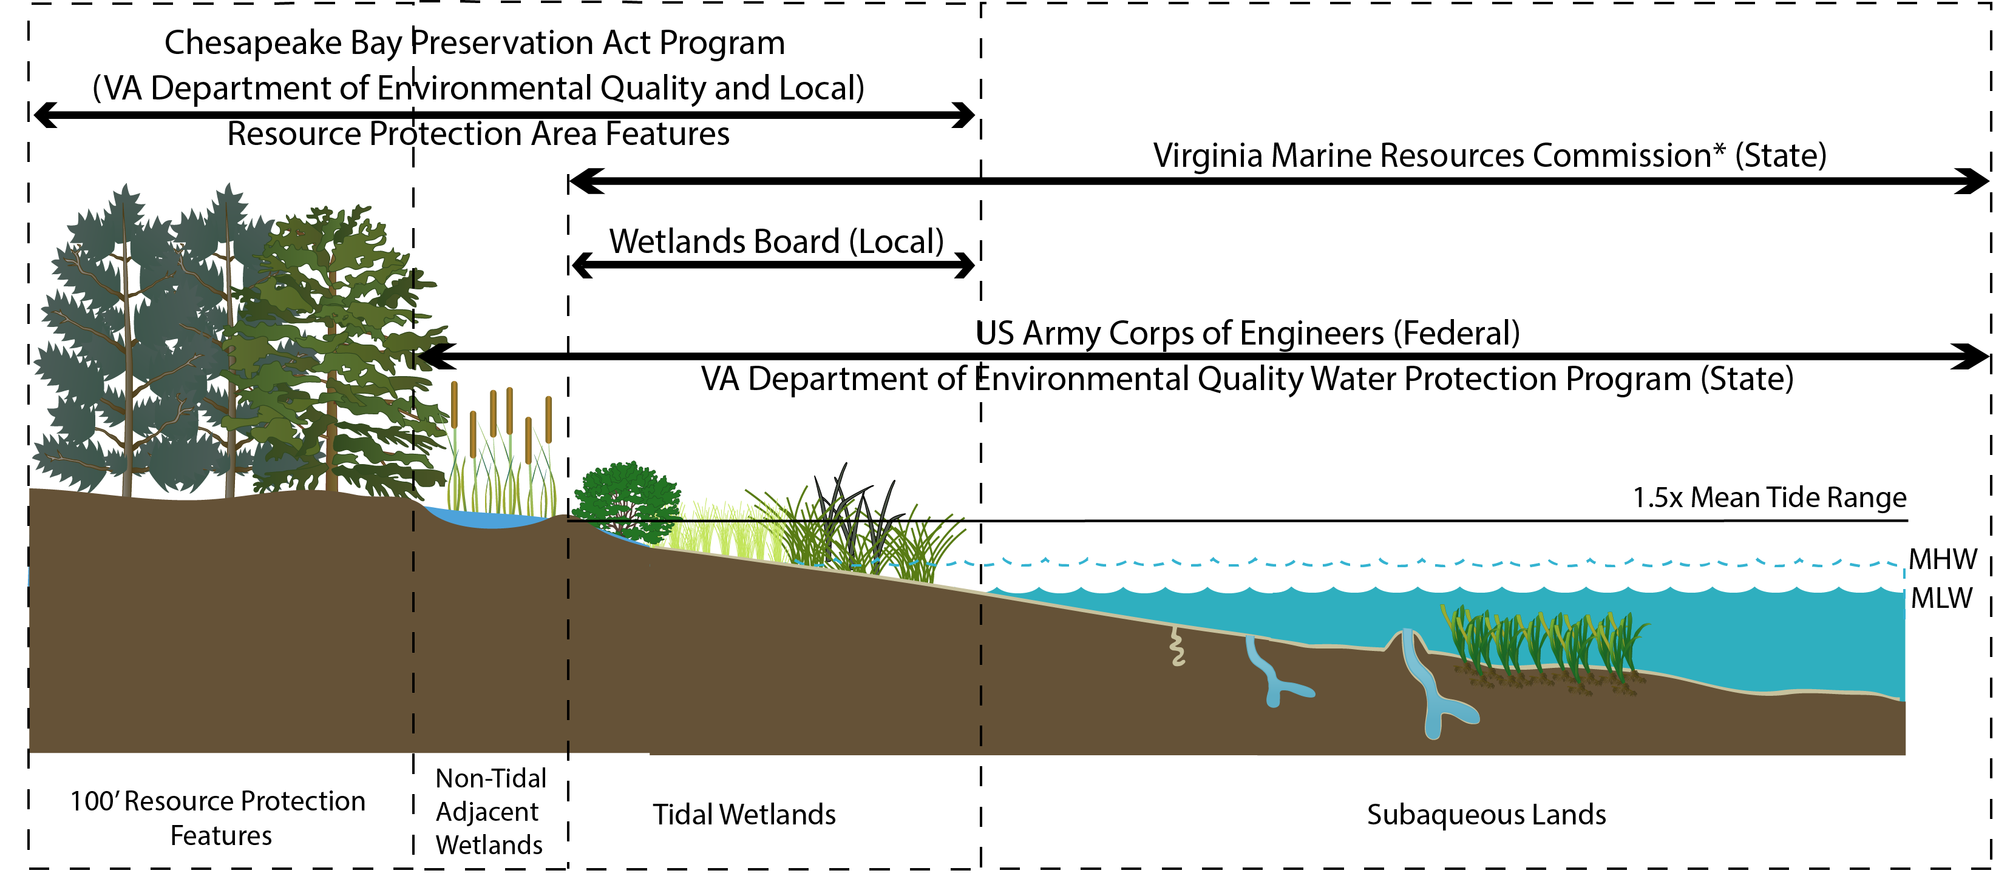
Notes:
RPA’s include Tidal Wetlands and Shores – Nontidal wetlands connected by surface flow and contiguous to tidal wetlands or water bodies to perennial flow – and a 100 feet buffer adjacent to and landward of those components

Slide 4
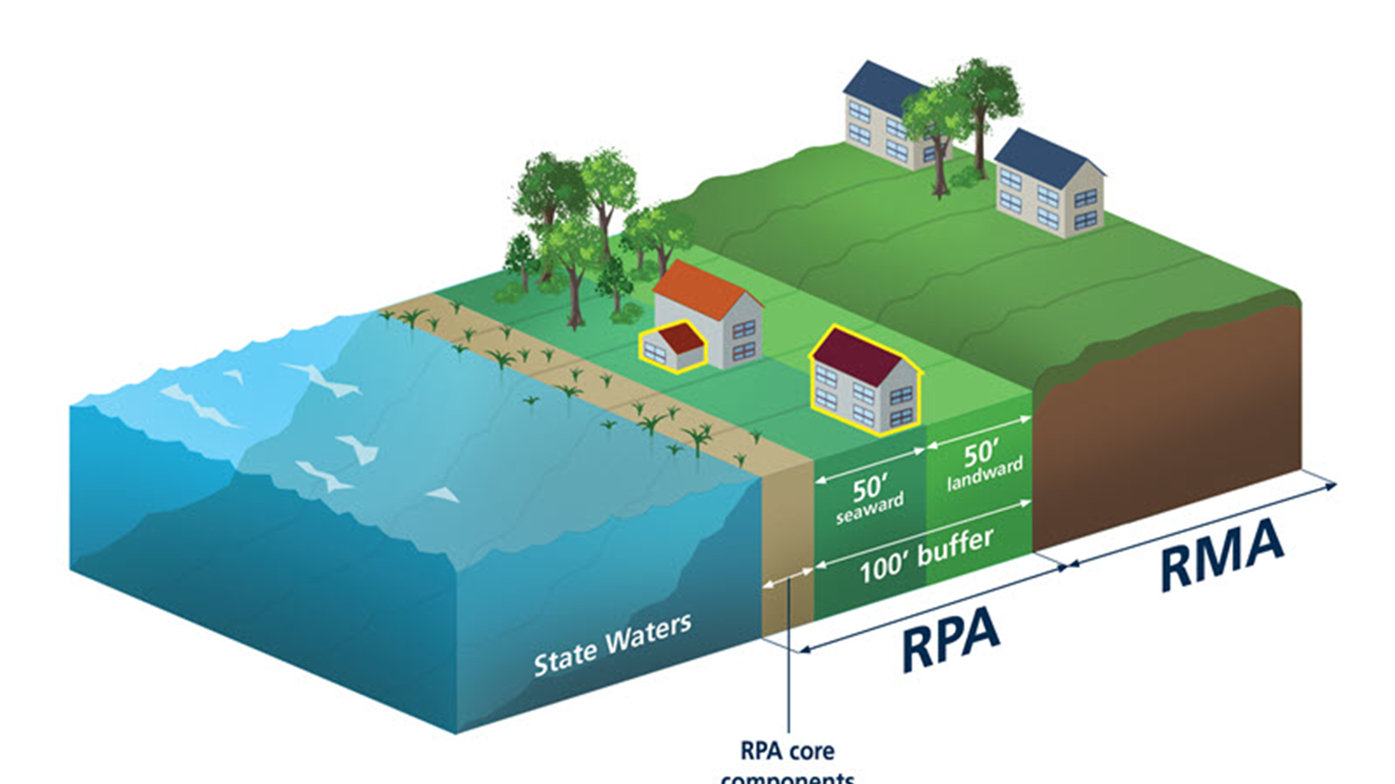

Slide 5
Resource Protection Areas
Activities within the RPA are heavily regulated and require local government approval.
Local RPA maps are not based on site-specific, field verified features:
Applicant or homeowner is often required to conduct a site-specific RPA delineation
Water Quality Impact Analysis (WQIA),including mitigation, are required for land disturbance in the RPA.
Notes:
Bullet 1:
Development is not permitted when there is sufficient buildable area outside the 100-foot buffer
Preserve indigenous vegetation, minimize impervious surfaces

Slide 6
Resource Protection Area Enforcement
Common Violations:
Unauthorized removal of trees or vegetation within the 100-foot RPA buffer
Unpermitted grading, fill, or clearing activities within designated RPAs
Construction or accessory structures without prior approval (e.g., patios, sheds, retaining walls)
Penalties and Remedies
Civil penalties
Stop-work orders; permit revocation
Mandatory restoration plans

Slide 7
RPA Enforcement Challenges
Complaint-Driven:
Enforcement typically triggered by citizen reports—reactive, not preventive.
Case-by-Case & Labor Intensive:
Each violation requires site inspections, documentation, and staff coordination.
Limited Local Capacity:
Many localities lack dedicated staff for proactive RPA monitoring or education.

Slide 8
Strategies to Minimize Unpermitted Activity Within the RPA
Industry Education:
Limited Impact: Licensure exam changes are unlikely to influence bad actors—many violations stem from small or out-of-state contractors who avoid permits, undercut competitors, and leave before enforcement occurs.
Mid- to large-scale developers retain consulting firms to manage environmental compliance
Disclosure:
Residential Property Disclosure Act (Virginia Code § 55.1-703)
Mandatory Disclosure

Slide 9
Annual RPA Notices to Homeowners
Option 1: Real Estate Tax Bill Notice:
Require localities to include a standardized RPA notice on annual real estate tax bills.
The notice would alert property owners to the presence of an RPA and direct them to local resources for mapping, restrictions, compliance requirements, and penalties
Option 2: Assessment Notice Disclosure:
Permit localities to include the same standardized RPA notice on annual property assessment notices.
In jurisdictions with annual reassessments, this provides equivalent reach using an existing communication channel.

Slide 10
Annual RPA Notices to Homeowners
Improves Long-Term Awareness
Reinforces property owner knowledge of RPA presence and restrictions beyond the point of sale.
Targets the Responsible Party
Directly notifies the legal landowner—the party accountable for compliance.
Low-Cost, High-Impact
Uses existing local government communication to deliver critical information with minimal administrative burden.

